Slide 1








Data Disaster
Clive Guo
Daksh Mukhra
Yvonne Thich

Slide 2


Greatest Sea Disaster in Modern History
Who survived the Titanic?
The unsinkable ship
Exploring the impact of sociological constructs
Deaths of two thirds onboard
How do socio-economic determinants affect survival?
How do associative determinants affect survival?
How do inherent determinants affect survival?
Intro
Data
Socio-economic
Associative
Inherent
Conclusion & Appendix

Slide 3

Data Preprocessing
Our Dataset
Table of Median Ages
Cleaning Age
- 891 passenger observations
- 12 features
- 20% missing values in Age
- Floating value ages
- Inconsistencies in Ticket
- 77% missing values in Cabin
Pclass
Title
1
2
3
Created new “Title” feature
Interpolated missing ages by finding median ages based on Title and Pclass
Compared floating age values to Title to verify validity of data
Dr
42.5
38.5
-
Mr
40
31
26
Mrs
41.5
32.5
31
Master
4
1
4
Cleaning Ticket
Ticket
Ticket No.
Optional string prefix before ticket number
Extracted Ticket Number from Ticket column
Miss
30
24
18
Intro
Data
Socio-economic
Associative
Inherent
Conclusion & Appendix

Slide 4
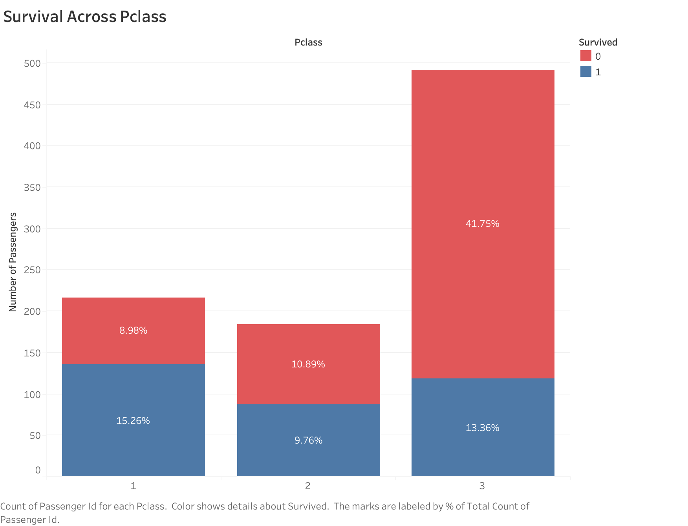
Does higher economic status lead to survival?
Survival Across Passenger Classes
First class 2 times more likely to survive than not
Second class equally likely to survive than not
Third class 3 times more likely to not survive
Intro
Data
Socio-economic
Associative
Inherent
Conclusion & Appendix

Slide 5
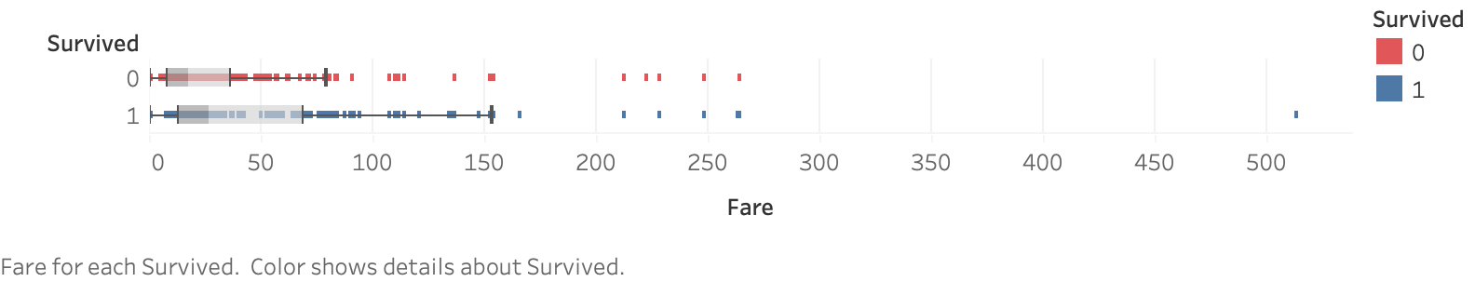
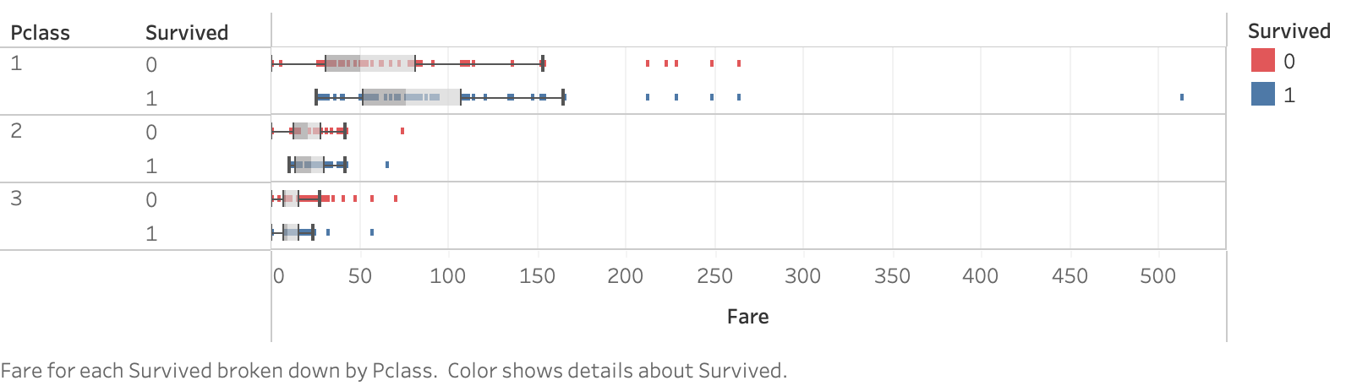
Do people who pay more survive?
Fare Price vs Survival
Higher passenger classes tend to pay more for their fares
Fare Price and Passenger Class vs Survival
First class tend to survive when they pay higher fares
Median: 50.5
Median: 76.5
Presence of survivors who paid less than some first class passengers
Paying higher fares to survive does not necessarily hold true
Median: 21
Median: 23
Median: 8.8
Median: 9.5
Intro
Data
Socio-economic
Associative
Inherent
Conclusion & Appendix

Slide 6

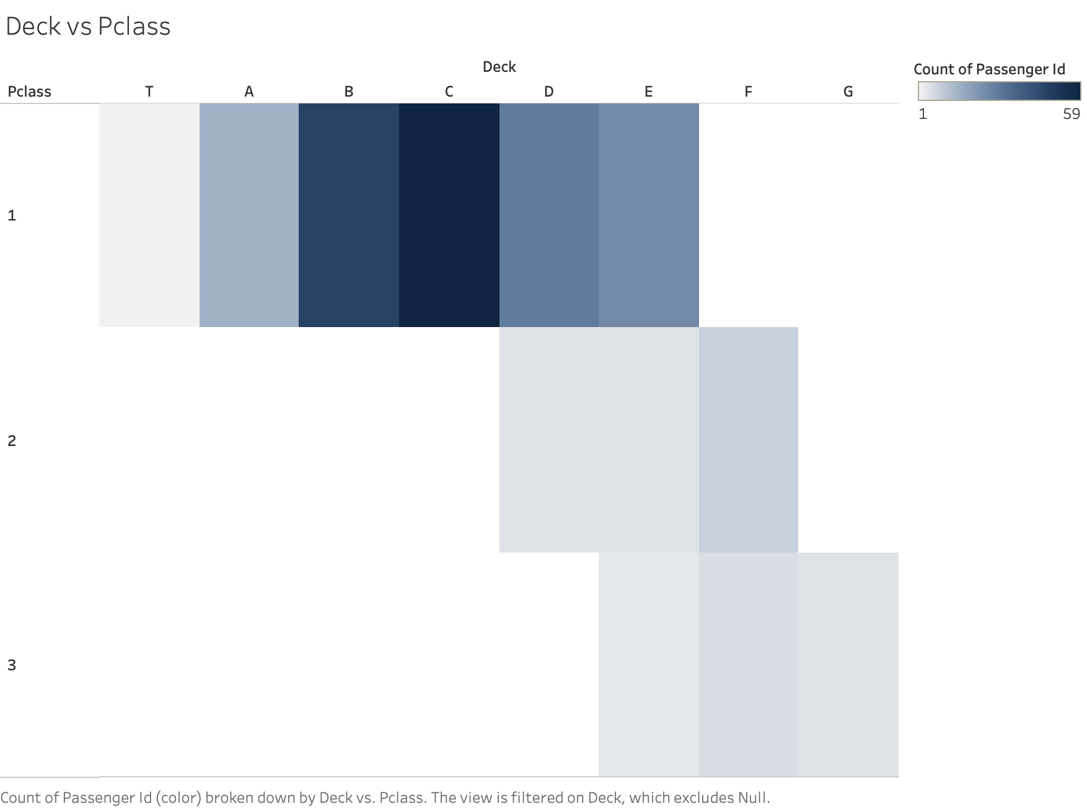
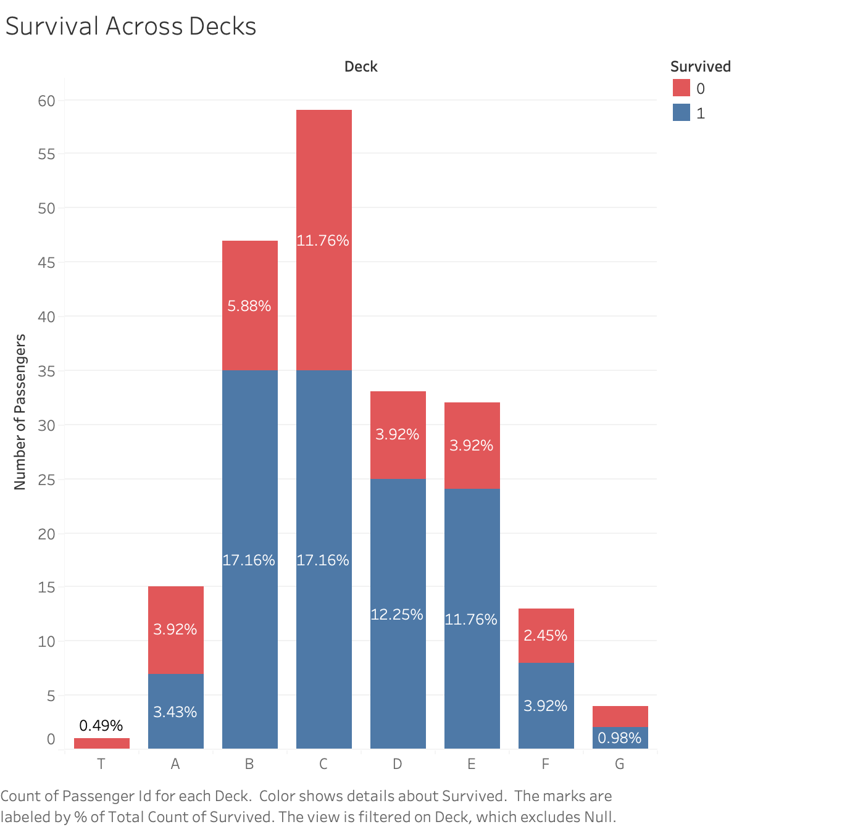
Does cabin location influence survival?
Heatmap of Passenger Class Distribution Across Decks
Cross Section of The Titanic
Survival Across Decks
Proximity to lifeboats does not positively correlate to chance of survival
Lifeboats here
T deck
A deck
B deck
C deck
D deck
E deck
Passenger on T deck should have survived based on hypothesis
F deck
G deck
Intro
Data
Socio-economic
Associative
Inherent
Conclusion & Appendix

Slide 7
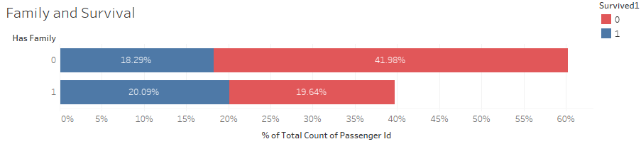
Does having family affect survival?
Family and Survival
60% of passengers did not have a family member onboard
However more than 50% of passengers with family members were third class
With a family member onboard, there was just over a 50% chance of survival
vs
Without family members onboard only just over 30% chance of survival
Intro
Data
Socio-economic
Associative
Inherent
Conclusion & Appendix

Slide 8
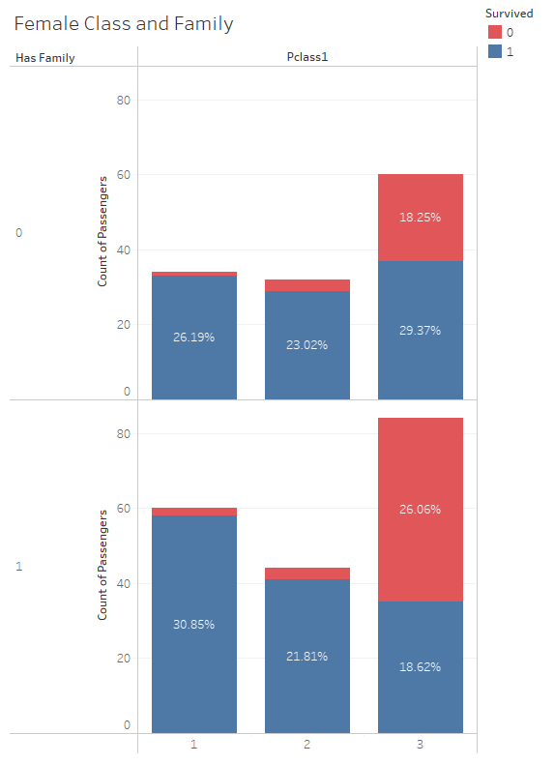
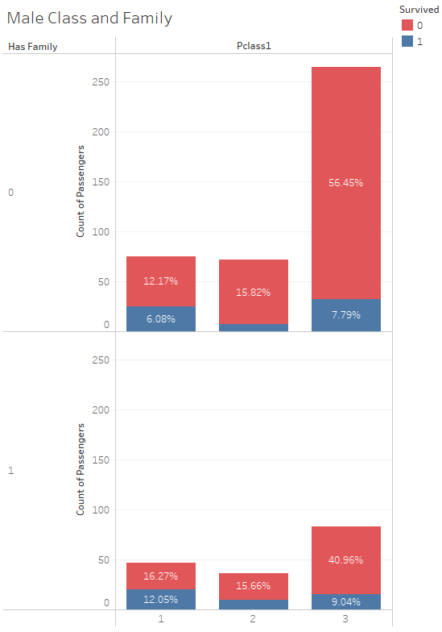
Does class in families affect survival?
Gender, Class and Family
Third class females with family had just 40% chance of survival compared to all other groups with over 50% chance of survival
Male survival was consistent across all passenger classes regardless of having family or not
Reasoning: Third class females may have felt more inclined to stay with family considering immigration context
Intro
Data
Socio-economic
Associative
Inherent
Conclusion & Appendix

Slide 9
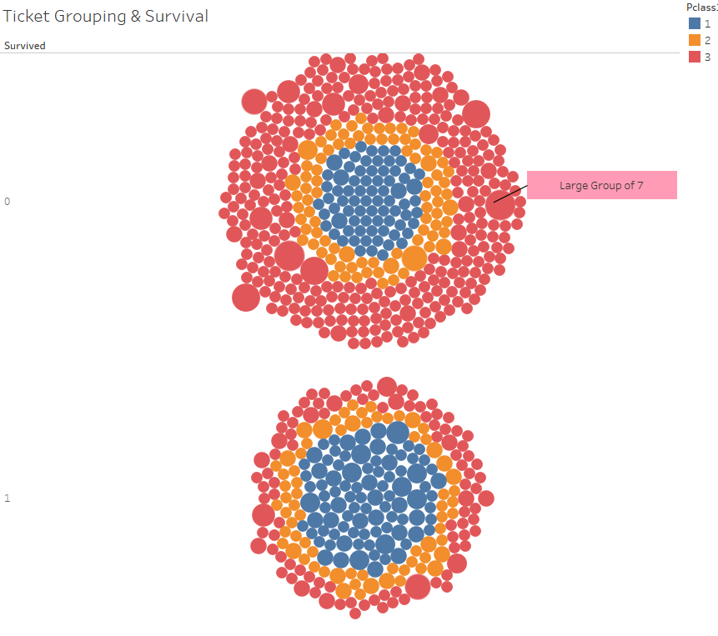
Does companionship affect your chances of survival?
Ticket Grouping
‘Groups’ could be friends or families that booked under the same ticket
No groups of more than 5 survived - all large groups of 5 of more were from third class
Reasoning: Third class groups and families may be more reluctant to leave friends and family behind - idea of immigration to start new lives may become obsolete without companionship and family
Intro
Data
Socio-economic
Associative
Inherent
Conclusion & Appendix

Slide 10
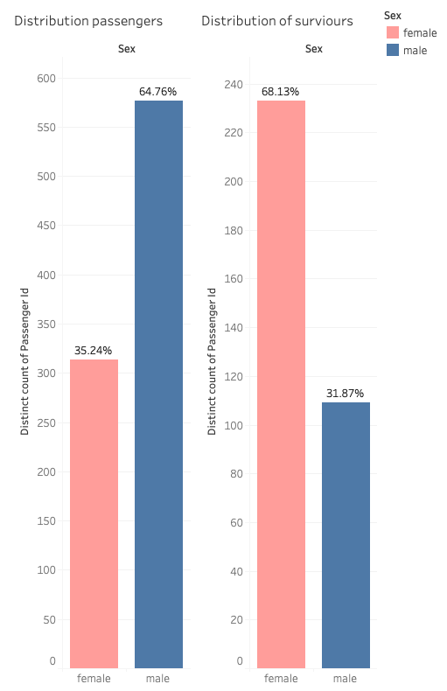
Does sex affect survival?
Survivors Across Sex
Females made up a disproportionate number of survivors
Looking at the distribution of sex within the survivors, 68% of all survivors were female despite only making up 36% of all passengers.
Intro
Data
Socio-economic
Associative
Inherent
Conclusion & Appendix

Slide 11
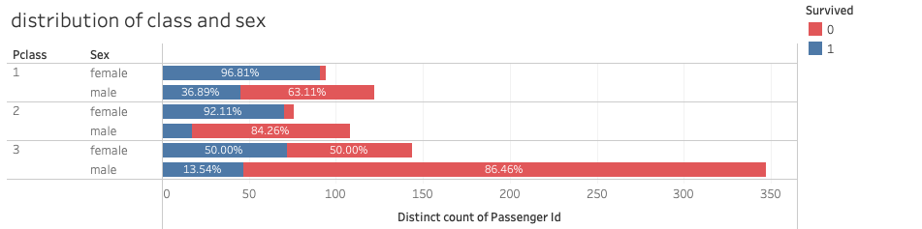
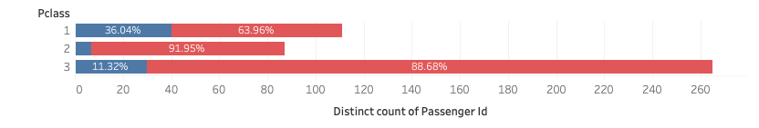
The Interplay of Class and Sex
Distribution of Class and Sex
Females overwhelmingly have a greater chance of survival compared to males across all three classes
Approximately only 8% of adult males in class 2 survived
This is our first sign of an altruistic act that has been committed on the Titanic - men have purposefully given up their spots in the lifeboats for women.
Survival Across Adult Males and Class
Intro
Data
Socio-economic
Associative
Inherent
Conclusion & Appendix

Slide 12
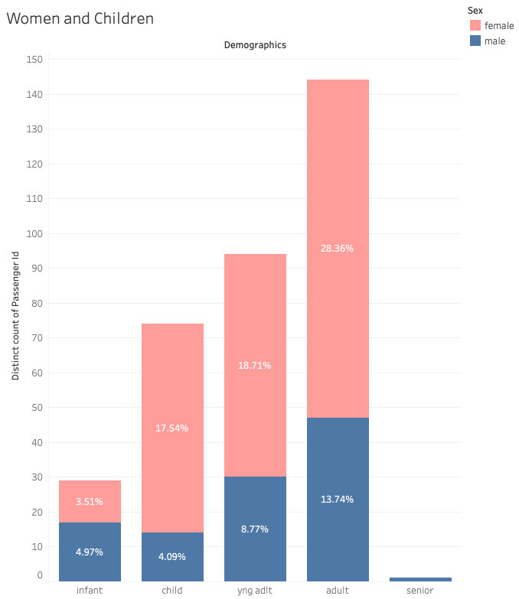

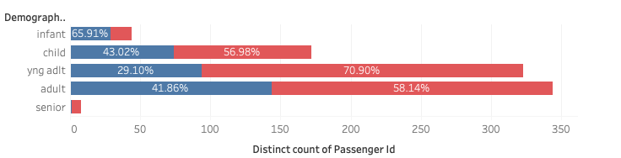
The Interplay of Age and Gender
Distribution of Survivors Across Age Bins
Infants had the greatest chance of survival with a survival rate of 66%. However it is not the case the older you are the lower your survival rate. Young adults had a lower survival rate than adults.
Effect of Sex on Survival Taking Account of Age
Females have a greater survival rate in children, young adults and adults
Only 23% of all survivors were adult males
Sex still takes priority in determining survival
Intro
Data
Socio-economic
Associative
Inherent
Conclusion & Appendix

Slide 13
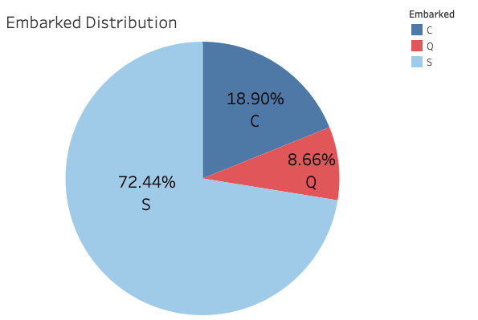
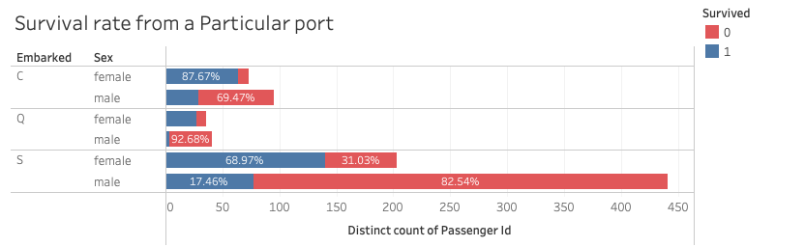
Does location embarked affect survival?
Distribution of Passengers Across Embarkation Points
Survival Rate From a Particular Port
Ports:
C - Cherbourg
Q - Queenstown
S - Southampton
Breaking down by sex and class, irrespective of where someone embarked, females still have a survival rate greater than or equal to males.
73% of all passengers embarked from Southampton and consequently most survivors are from Southampton
Intro
Data
Socio-economic
Associative
Inherent
Conclusion & Appendix

Slide 14


Conclusion
So who survived the Titanic?
Sex was the single most important factor in determining who was going to survive
Survival rates will be influenced if you are in a higher class or whether you are younger.
Ultimately if you split any combination of groups by sex, females had a greater chance of survival.
Intro
Data
Socio-economic
Associative
Inherent
Conclusion & Appendix

Slide 15
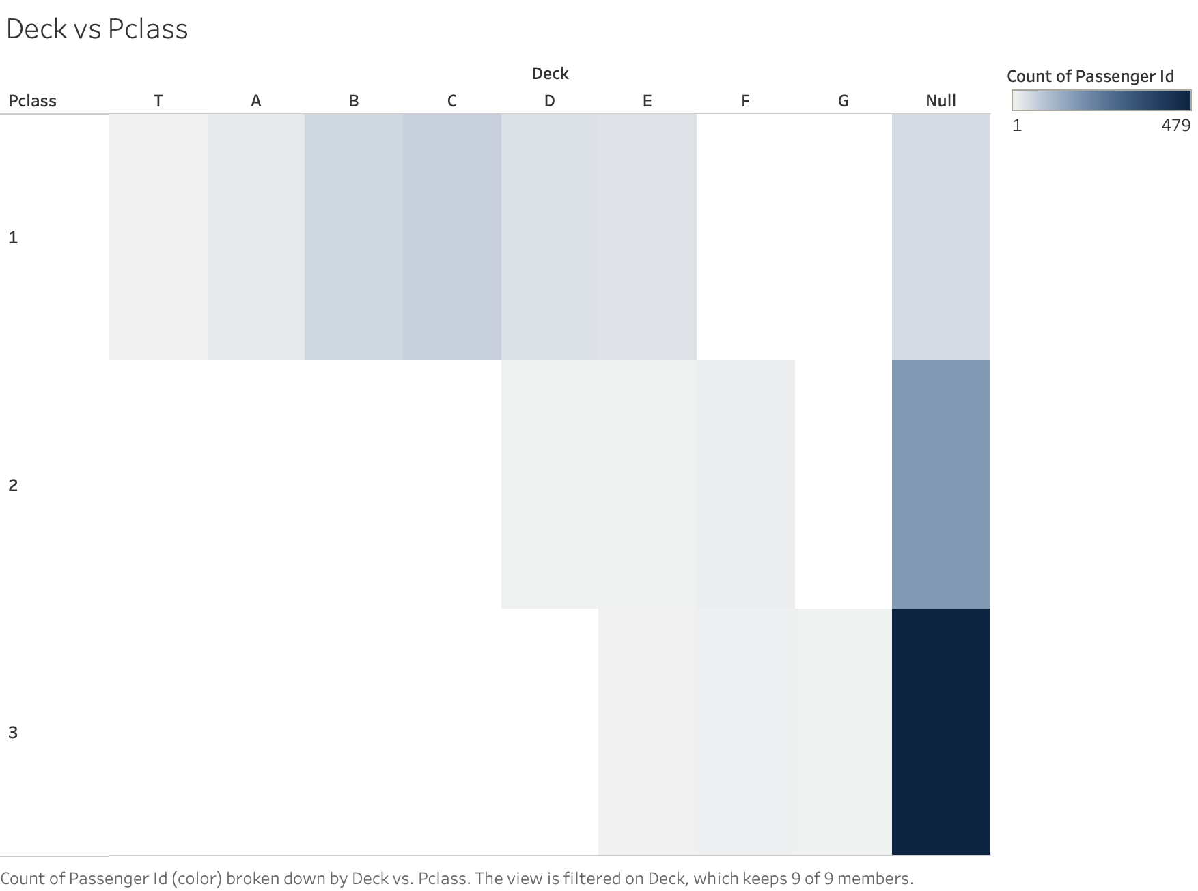
Appendix
Intro
Data
Socio-economic
Associative
Inherent
Conclusion & Appendix

Slide 16
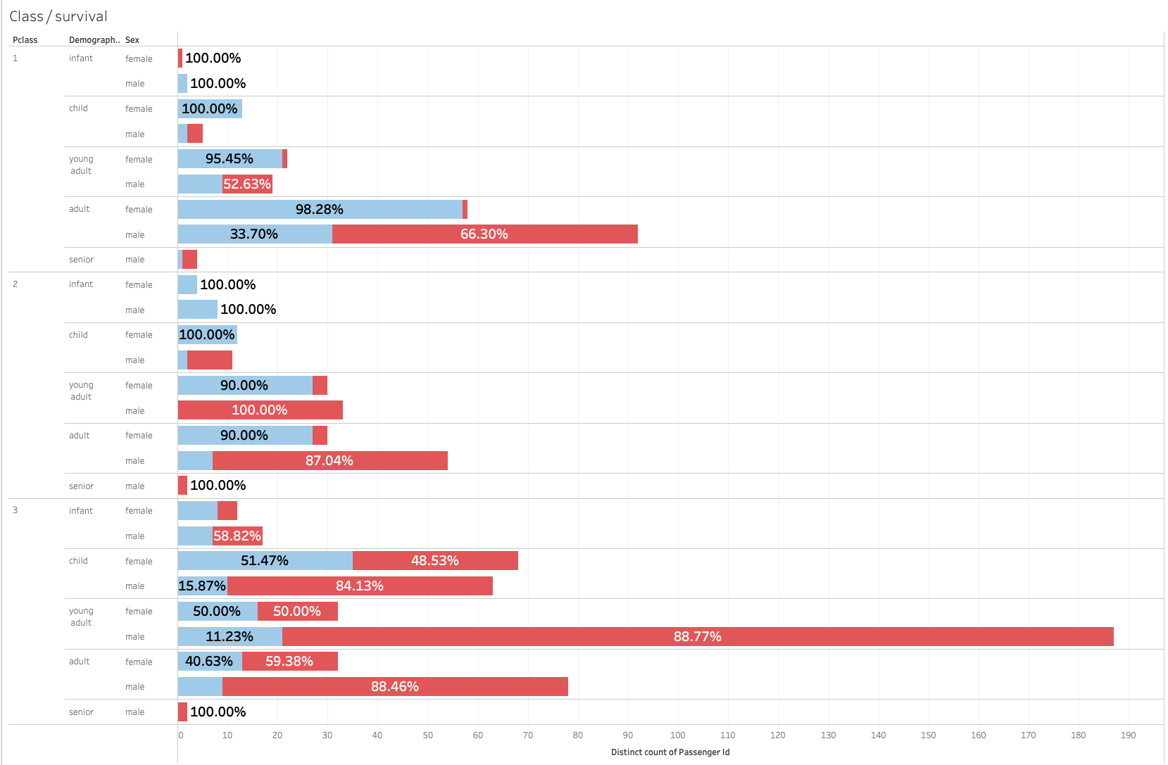
Appendix
Sex is the most important factor in determining survival
There is not a single combination of factors in which a male has a higher chance of survival than a female across all ages and classes.
The Importance of Sex
Intro
Data
Socio-economic
Associative
Inherent
Conclusion & Appendix

